Slide 1
WP3 – Data Catalogues for Photon and Neutron Science
Alun Ashton Tobias Richter
ExPaNDS – Paul Scherrer Institute PaNOSC – European Spallation Source ERIC
November 2020
This project has received funding from the European Union’s Horizon 2020 research and innovation programme under grant agreement No. 823852

Slide 2
Overview
Introduction
Use cases
Photon and Neutron User – Federated PaN Search API
Interdisciplinary Researcher – Repository Metadata Harvesting
Summary

Slide 3

WP3 in the PaN Data Lifecycle
Create
Experiment
Measurements
Collect Metadata
Plan
Data formats
Storage
Sources
Metadata
Proposal
Curate
Store and Archive
Metadata &
Data
Access
Share Data
Access Controlled or Open Access
Analyse
Integrate Data
Create Output
Publish Results
Process
Store Data
Validate Data
Visualize Data
Papers
Data Publication Reuse
Papers
Papers

Slide 4
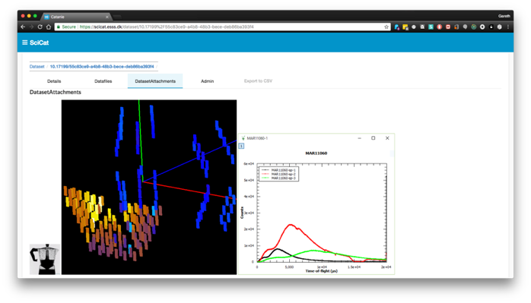



Data Catalogues – Common Functions
Catalogues are an entry point to other EOSC services, often provided by the facilities, like Download, Processing, Analysis or Visualisation Services.
Store reference to raw data and the relevant metadata to identify interesting dataset to work with.
Information available often includes:
Proposal Information
Sample Information
Experimental Parameters
Previews
Provenance
Relationship to derived datasets
Relationship to people
Catalogues also Facilitate Data Re-Use, Sharing and Publication via PIDs and DOIs.

Slide 5
Different starting conditions at different facilities
6 European PaNOSC facilities and 10 national ExPaNDS facilities
Few are in construction and generate no user data yet
Most have a (meta-)data catalogue
Implementations are often institute specific
Others collaborate on SciCat or ICAT
Some catalogues stores sufficient data required to locate a specific dataset
Many publish data after an embargo with a DOI
Most write HDF5 data files
All aim to follow the NeXus standard for raw data
Follow common schema for data, metadata

Slide 6
Use case One – A PaN facility user

Slide 7

PaN Facility Users/Data Owners
Securely search for their own data at a facility
Securely search for their own data across facilities
Searching for open data
Based on Experiment Configuration
Based on Sample and Sample Conditions
Why?
Process/reprocess data (WP4)
Integrate Interoperable data (WP4)
Publish data/Link to publication (WP2)
ICAT Site API
SciCat Site API
Custom Site API
PaN
Facilities
Catalogue
Service
ICAT
Catalogue
Service
SciCat
Catalogue
Service
Custom
Database
Database
Database

Slide 8
Portal
Common REST API
Common REST API
Common REST API
Abstraction
Adapter Interface Layer
Adapter Interface Layer
Adapter Interface Layer
ICAT Site API
SciCat Site API
Custom Site API
PaN
Facilities
Catalogue
Service
ICAT
Catalogue
Service
SciCat
Catalogue
Service
Custom
Database
Database
Database

Slide 9
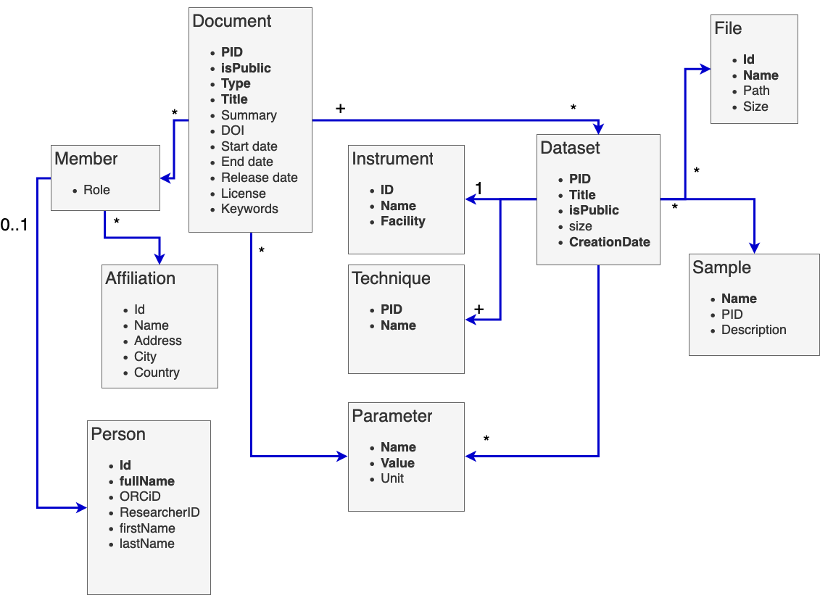
Common REST API (PaN API V1.0)
REST API operates on a fairly generic set of classes. That simplifies the implementation at different data catalogues.
Domain Specific Value of the API lies in curated dictionaries ontologies and local mappings for:
Experimental Techniques
Parameters for
Sample and Sample Conditions
Experiment Configuration
Supported Units with Conversions
Roles for People

Slide 10
Federated Data Search Service
Portal
Common REST API
Common REST API
Common REST API
Abstraction
Adapter Interface Layer
Adapter Interface Layer
Adapter Interface Layer
Federated Processing Service
ICAT Site API
SciCat Site API
Custom Site API
PaN
Facilities
Catalogue
Service
ICAT
Catalogue
Service
SciCat
Catalogue
Service
Custom
Database
Database
Database

Slide 11
PaN Facility Users/Data Owners
Securely search for their own data at a facility
Securely search for their own data across facilities
Searching for open data
Based on Experiment Configuration
Based on Sample and Sample Conditions
Why?
Process/reprocess data (WP4)
Integrate Interoperable data (WP4)
Publish data/Link to publication (WP2)

Slide 12
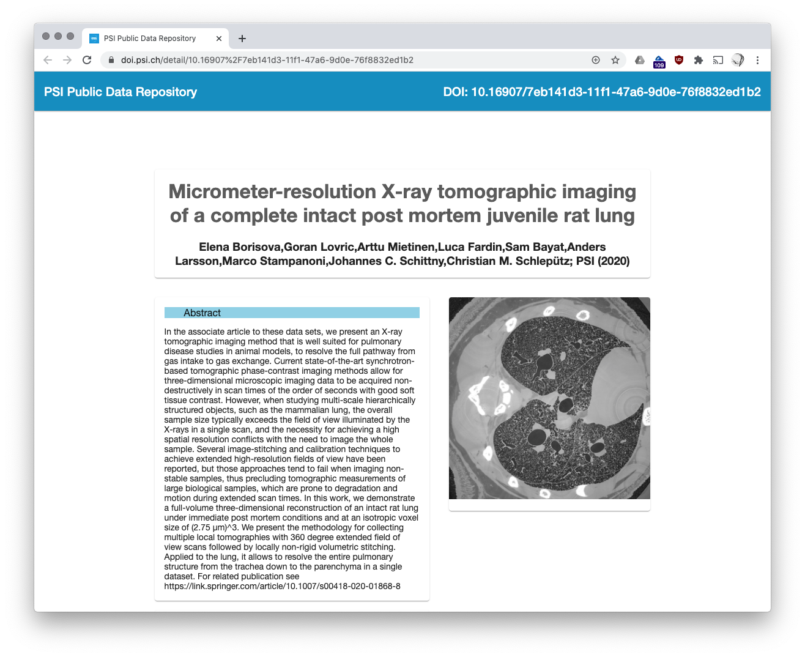
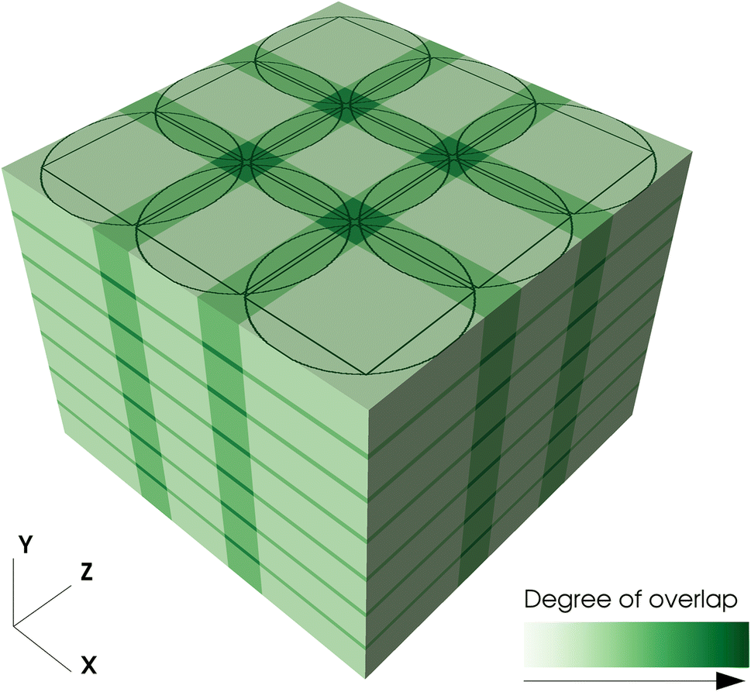
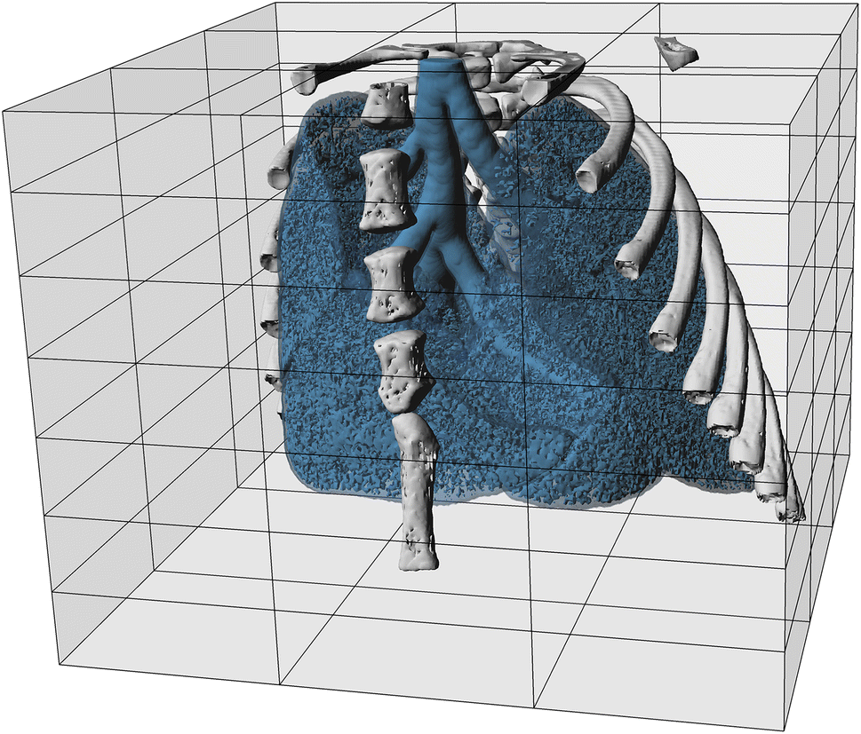
Supporting PaN Research
Technique Development
Pulmonary disease studies in animal models to resolve the full pathway from gas intake to gas exchange.
Mainly focuses on technical details of acquisition and post-processing steps.
Published as an open access dataset (https://doi.org/10.16907/7eb141d3-11f1-47a6-9d0e-76f8832ed1b2) and may serve for future studies of lung structure and function in normal and pathological conditions at a new level of resolution and detail.
~2Tb of data published February 2020

Slide 13
Use case Two – Interdisciplinary researchers

Slide 14
Supporting non-PaN
How to reach the wider community
Datasets from Photon and Neutron facilities can be useful in many scientific domains
The domain specific search API requires some knowledge and investment from the potential user
Generic (EOSC-hosted) data repositories fill the gap: They are available to everyone and carry information on datasets from a wide range of disciplines
🔎
imaging rat lung

Slide 15
Harvesting by Data Repositories
How to get PaN data out there
Data is pushed to existing services for immediate and wide reach
Facilities operate public endpoints providing access via known protocols and metadata schemas. PaNOSC chose OAI-PMH, due to broad support.
Any foreign repository is free to harvest (copy) the entire public metadata collection.
Meta-data schema is limited to what is common to most science areas (Dublin Core or equivalent). Extensions are possible, especially where there is a potential cross discipline agreement. Example: B2find carries “instrument”.
This allows a generic user to type in their search terms into some widely known and adopted EOSC service. The results will be generated from the fully public metadata in the local database on the service. The original datasets still reside at the facility.

Slide 16

Interdisciplinary Data Repositories
OAI-PMH
OAI-PMH
OAI-PMH
Abstraction
Adapter Interface Layer
Adapter Interface Layer
Adapter Interface Layer
ICAT API
SciCat API
Custom Site API
PaN
Facilities
Catalogue
Service
Catalogue
Service
Catalogue
Service
Custom
Catalogue
ICAT
SciCat
Database
Database
Database

Slide 17
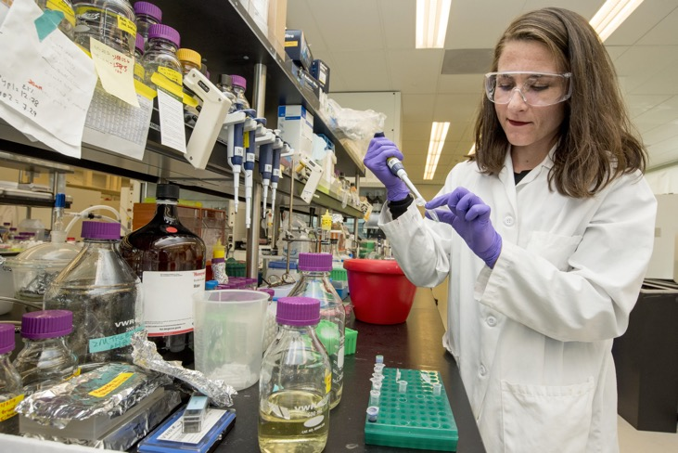
Common Metadata Expression
PaNOSC and ExPaNDS facilities work together to find common vocabularies for metadata, based on community standards like the NeXus file format most facilities use for raw data.
Finding common ground with other communities makes all exposed metadata more accessible.
We have ongoing discussions around:
Roles for persons involved with the data
Experimental or Measurement Technique
Sample & Parameters
Instrument & Parameters
Photo by Science in HD on Unsplash
Photo by Jossuha Théophile on Unsplash
Photo by Science in HD on Unsplash

Slide 18
Summary

Slide 19
Two Routes for Opening Datasets
 | Harvesting | Custom Search
Exposure Method | Push Metadata resides in third party EOSC repository | Pull Metadata stays at facility
Time to Market | Quick (existing solution) | Duration of PaNOSC
Data under embargo | Cannot be exposed | After Authentication
Richness of Metadata | Common Schema (Dublin Core initially) | Domain Specific Metadata
Target User Group | Citizen Scientists, Interdisciplinary Science Community | Photon and Neutron Facility Users
EOSC Repo
EOSC User
Metadata
Query
Facility 1
Facility 2
Facility 3
Facility 3
Facility 2
Facility 1

Slide 20
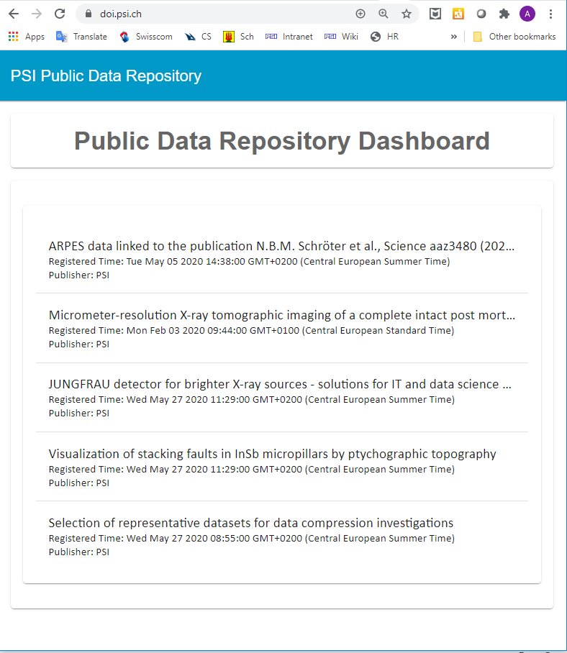
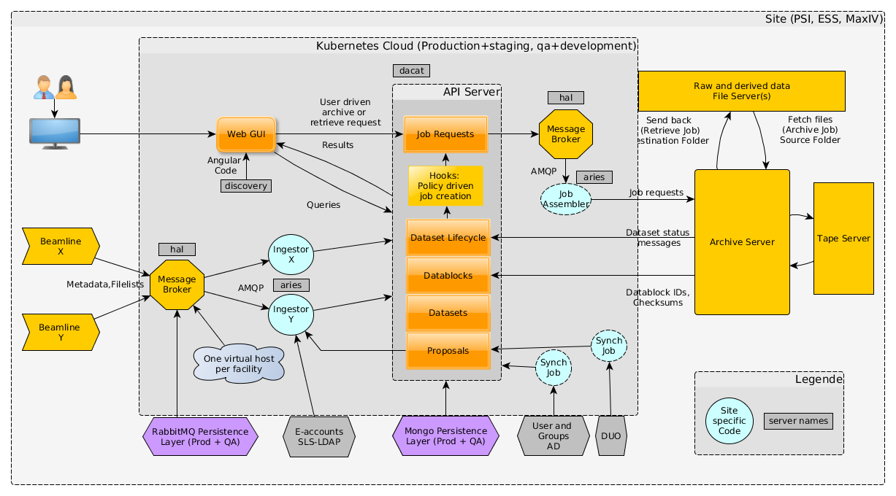
Prerequisites
PaN Facilities
Choosing a Catalogue
Minimum Product
Facility Integration
PBs of data a year
PaN Communities
PaN Implementations
EOSC Integration

Slide 21
Summary
Major activities completed in the past year:
OAI-PMH implementations and harvesting ongoing
with help from B2FIND and OpenAIRE
PaN search API v1.0 defined and implementation ongoing
Report on status, gap analysis and roadmap towards harmonised and federated metadata catalogues for EU national Photon and Neutron RIs
Upcoming deliverables:
PaN Ontology v1.0 to be released in Spring 2021
Federated search demonstrator to be released in Spring 2021

Slide 22
Thank you
alun.ashton@psi.ch
tobias.richter@ess.eu
wp3-expands.eu@desy.de (joint address for both projects)

